Slide 1

TRƯỜNG CAO ĐẲNG LÝ TỰ TRỌNG TP. HỒ CHÍ MINH

Slide 2

KHOA KHOA HỌC CƠ BẢN

Slide 3

ỦY BAN NHÂN DÂN THÀNH PHỐ HỒ CHÍ MINH
TRƯỜNG CAO ĐẲNG LÝ TỰ TRỌNG TP. HỒ CHÍ MINH
Bậc đào tạo: TRUNG CẤP CHUYÊN NGHIỆP
Tên giảng viên: LÊ NGUYỄN MỸ TRÂM

Slide 4
Good afternoon class 19T2.

Slide 5

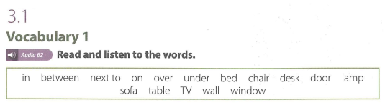
UNIT 3: LOCATIONS

Slide 6
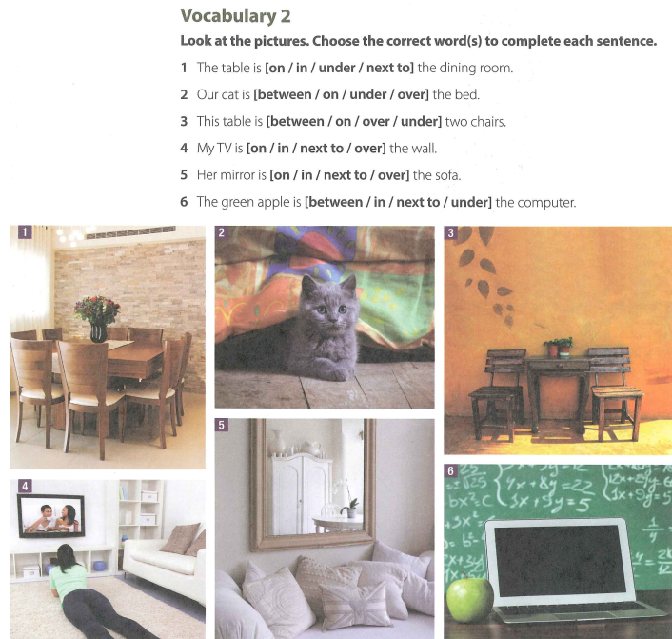

Slide 7
VOCABULARY 2 (KEY)
  The table is [on / in / under / next to] the dining room.
  Our cat is [between / on / under / over] the bed.
  This table is [between / on / over / under] two chairs.
  My TV is [on / in / next to / over] the wall.
  Her mirror is [on / in / next to / over] the sofa.
  The green apple is [between / in / next to / under] the computer.

Slide 8
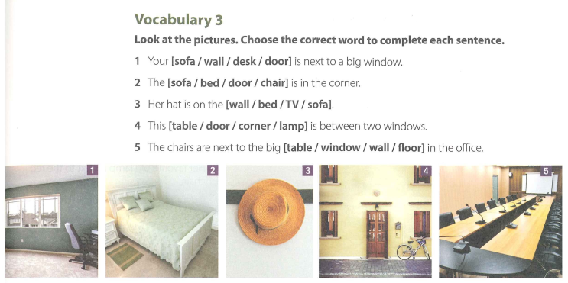

Slide 9
VOCABULARY 3 (KEY)
Your [sofa / wall / desk / door] is next to a big window.
The [sofa / bed / door / chair] is in the corner.
Her hat is on the [wall / bed / TV / sofa].
This [table / door / corner / lamp] is between two windows.
The chairs are next to the big [table / window / wall / floor] in the office.

Slide 10
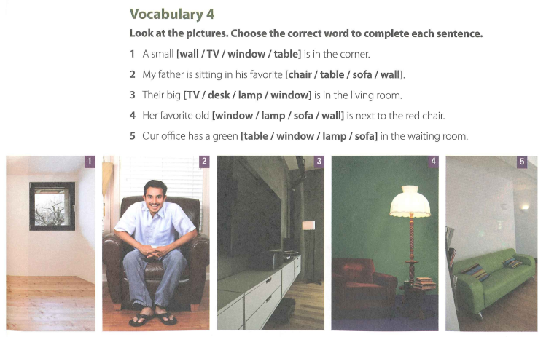

Slide 11
VOCABULARY 4 (KEY)
A small [wall / TV / window / table] is in the corner.
My father is sitting in his favorite [chair / table / sofa / wall].
Their big [TV / desk / lamp / window] is in the wing room.
Her favorite old [window / lamp / sofa / wall] is next to the red chair.
Our office has a green [table / window / lamp / sofa] in the waiting room.

Slide 12
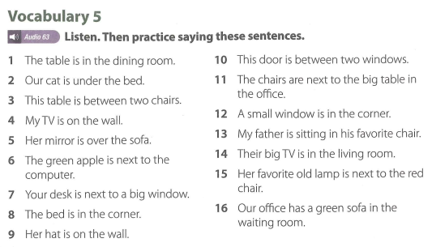

Slide 13
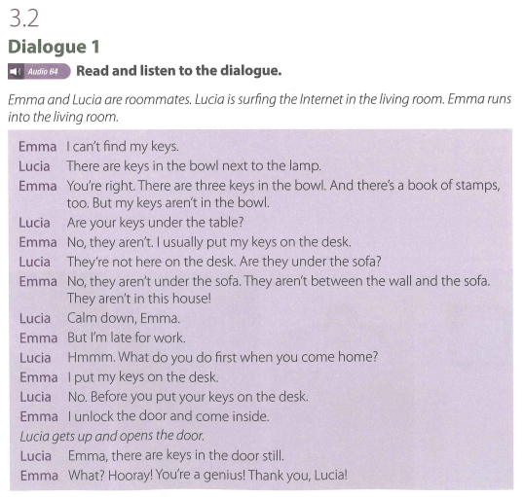

Slide 14
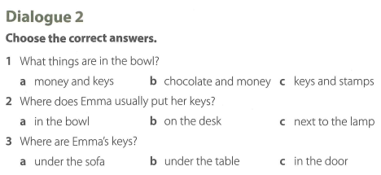

Slide 15
Dialogue 2 (Key)
1. What things are in the bowl?
a money and keys
b chocolate and money
c keys and stamps
2. Where does Emma usually put her keys?
a in the bowl b on the desk
c next to the lamp
3. Where are Emma’s keys?
a under the sofa
b under the table c in the door

Slide 16

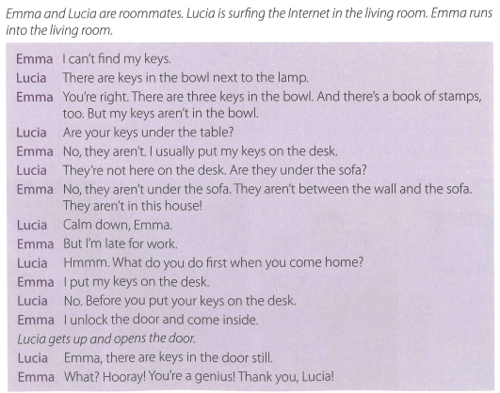

Slide 17
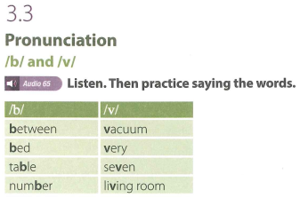

Slide 18
Thank you very much
for
your cooperation.

